Slide 1
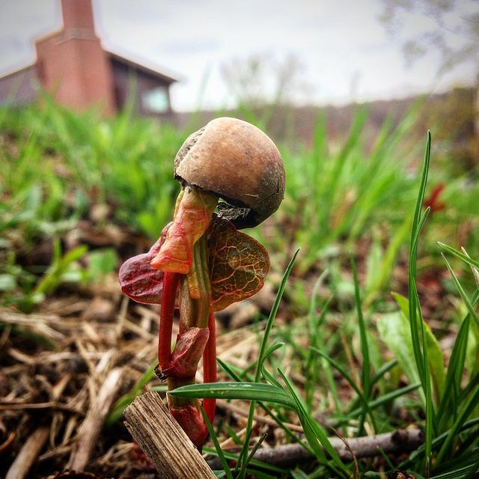
DAC 2022: Phenological sensitivity as a mediator of plant interactions
Dan Buonaiuto, Harvard University
Feb 14, 2022

Slide 2
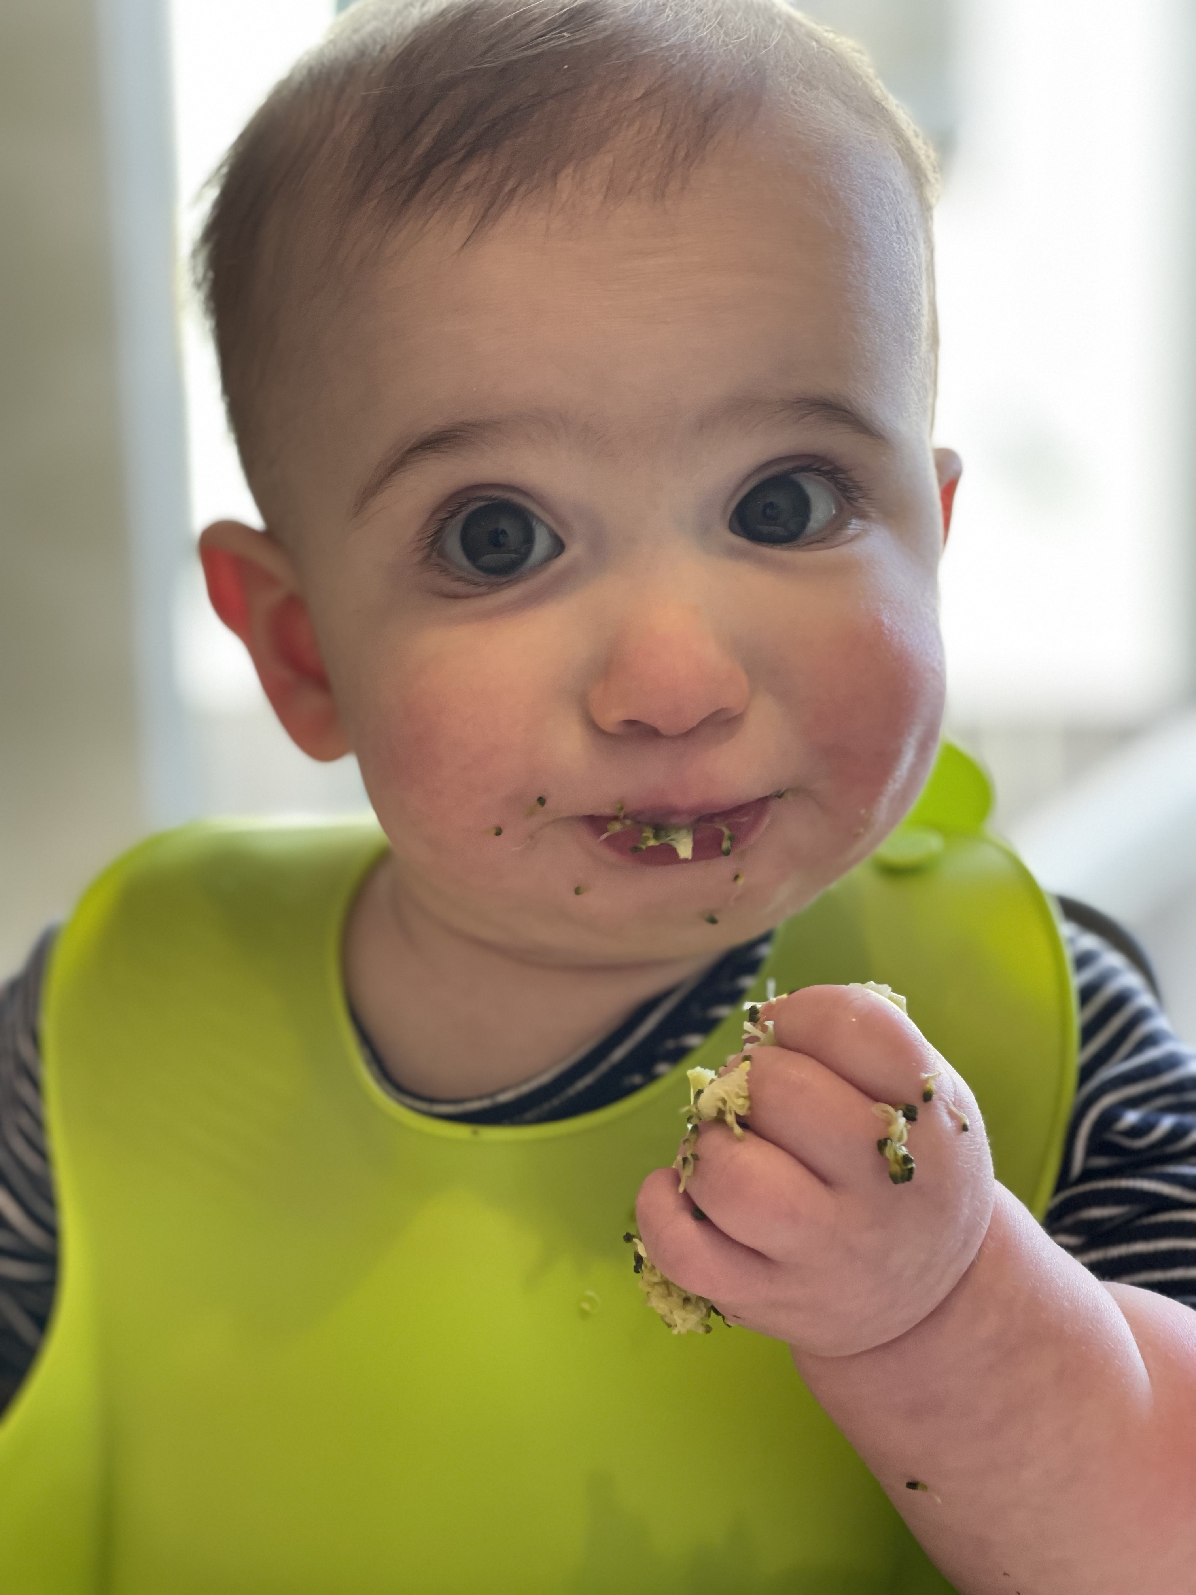
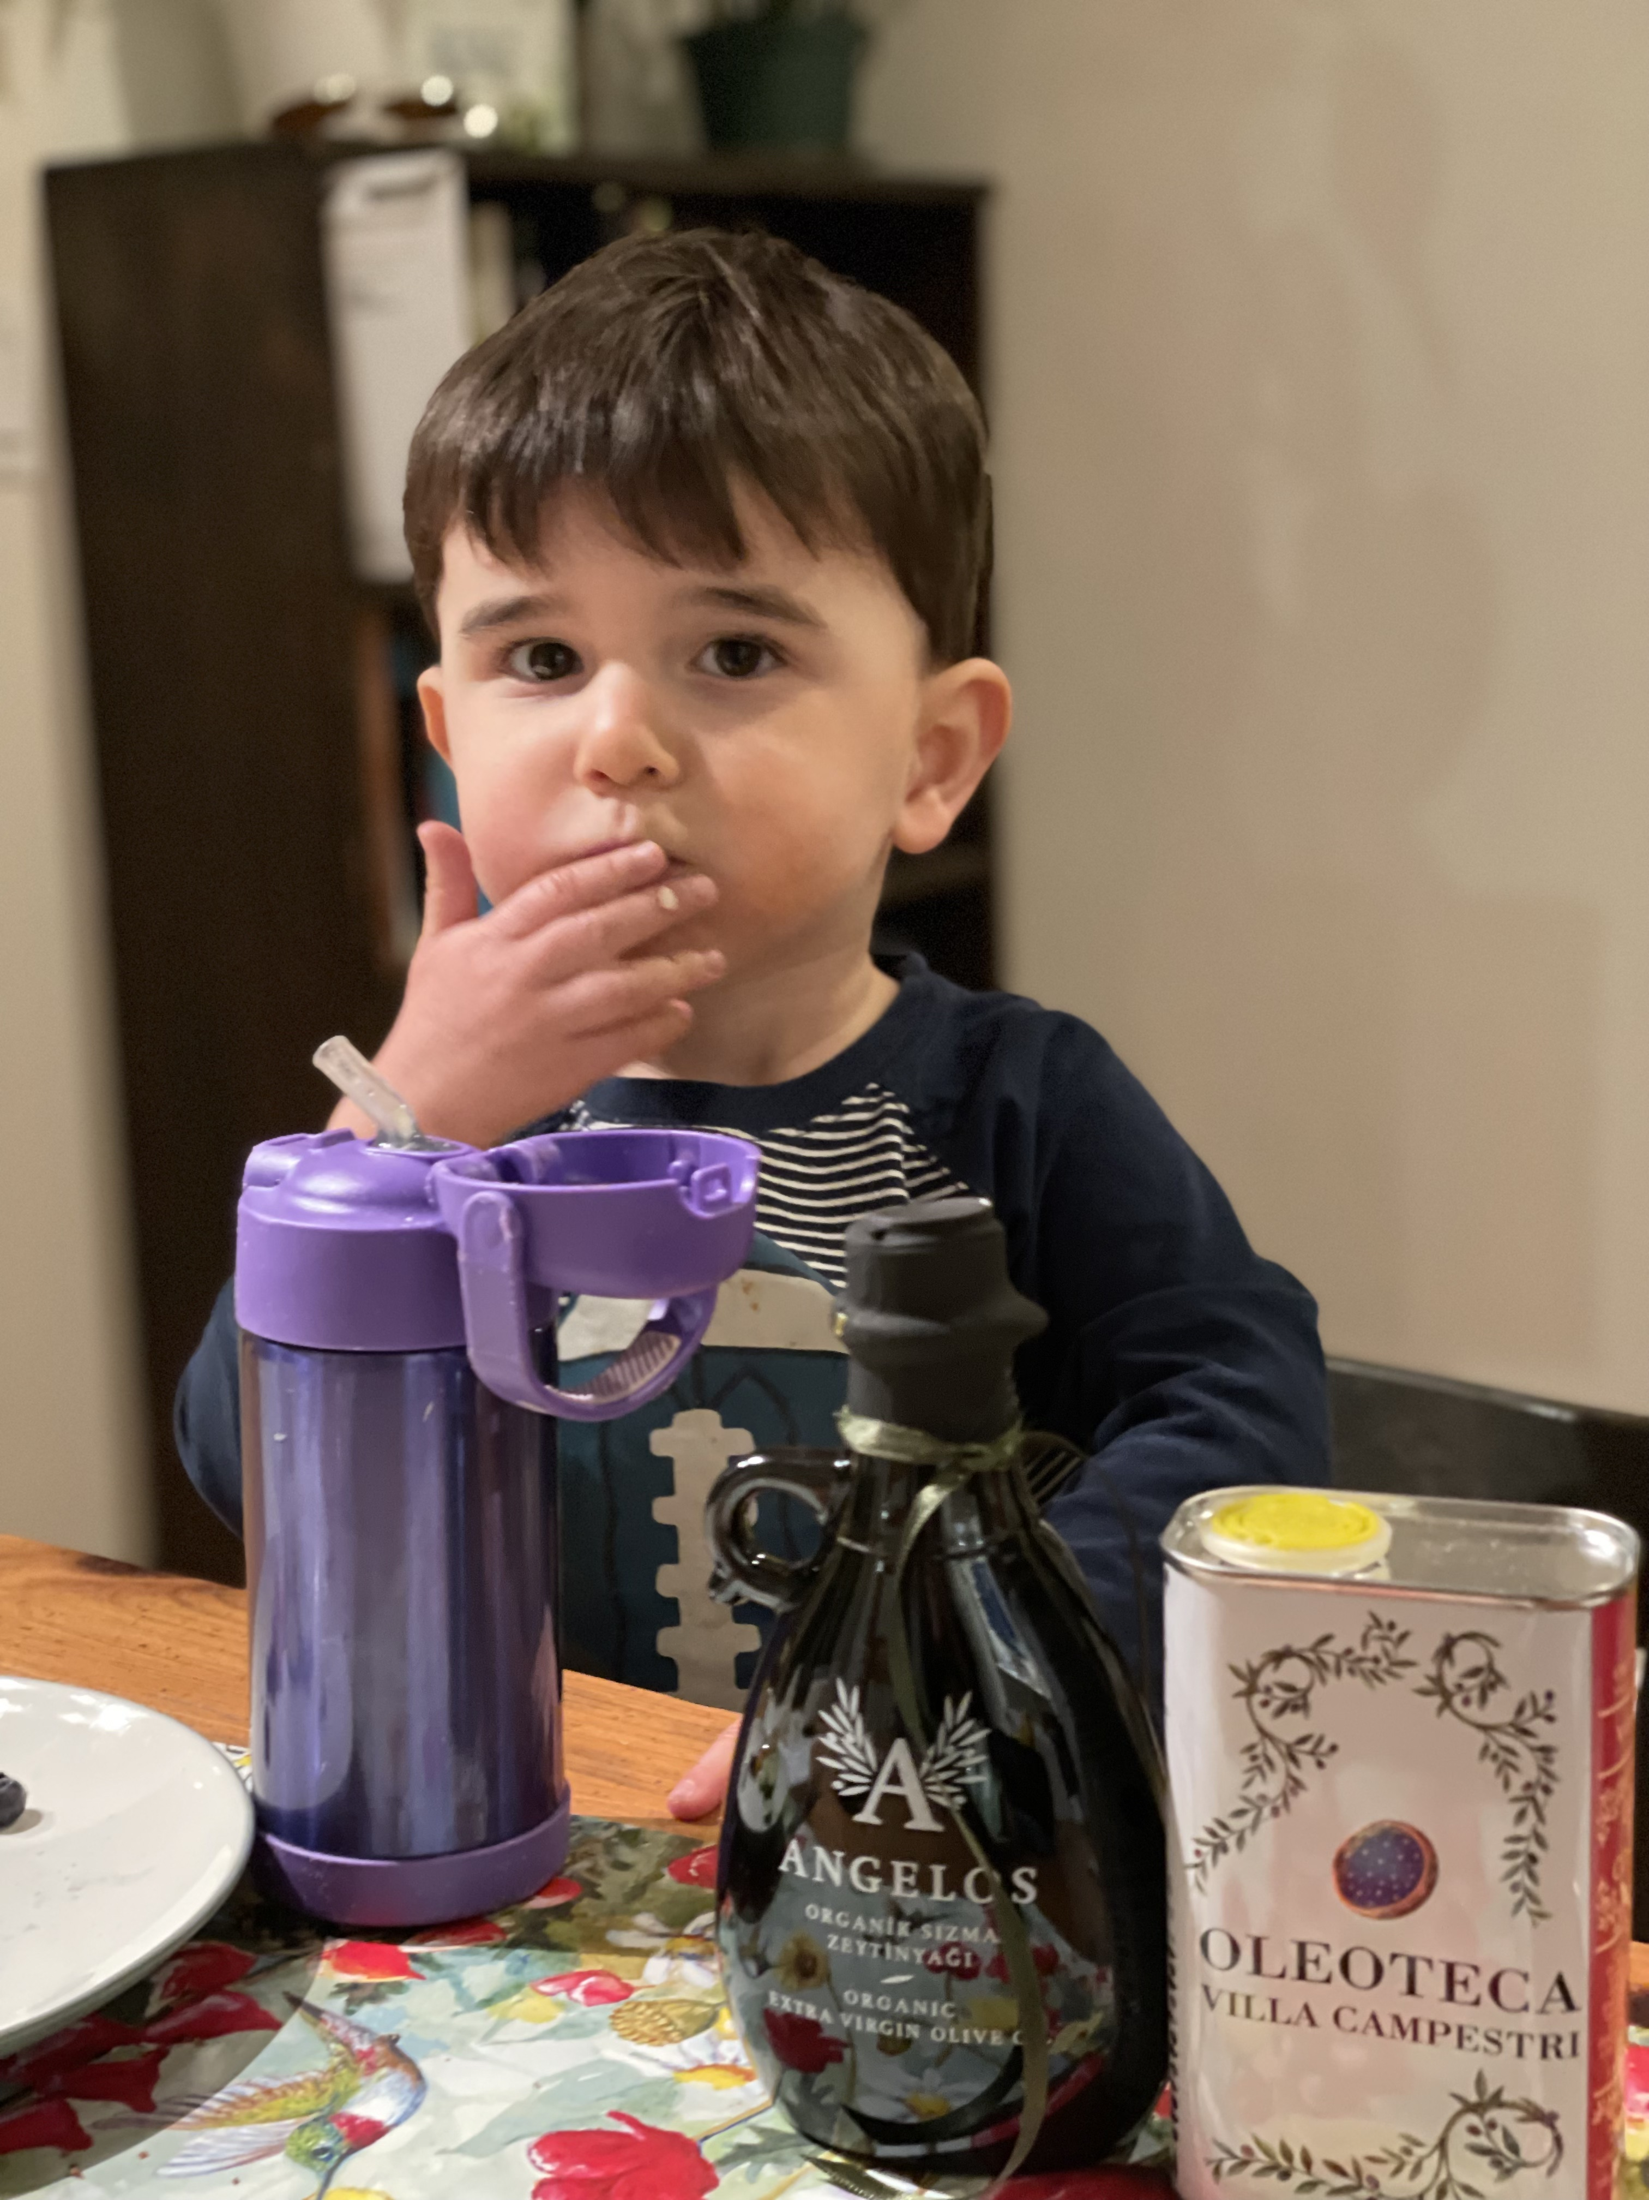

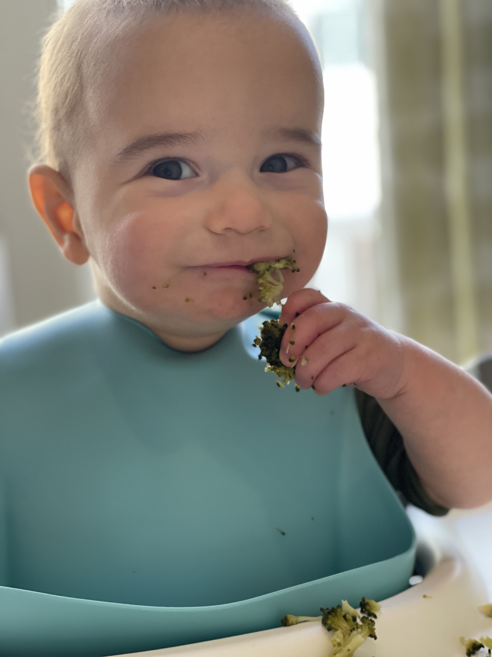
Last DAC: Winter 2020

Slide 3
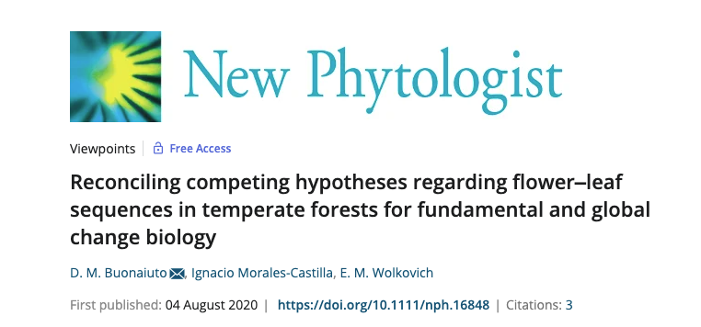
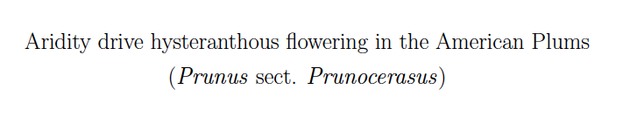
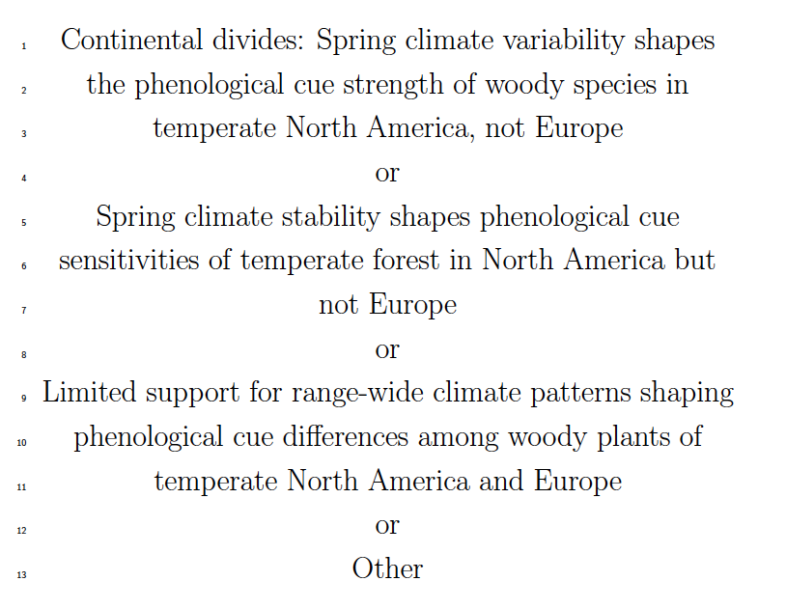
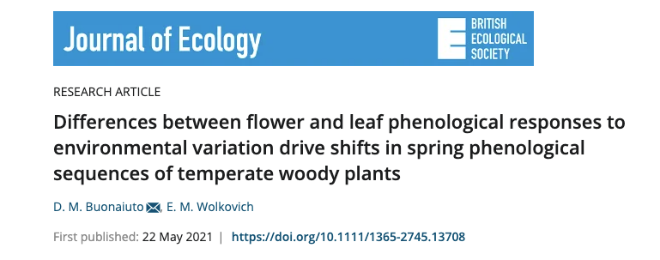
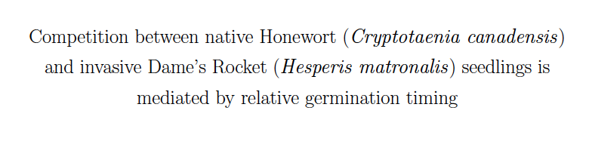
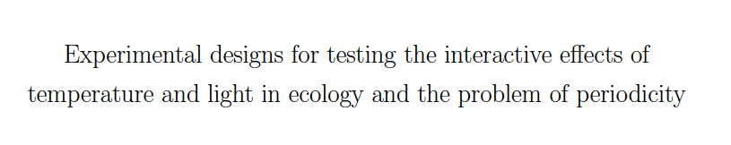
S
Ch1
Ch2
Ch3
Ch4

Slide 4
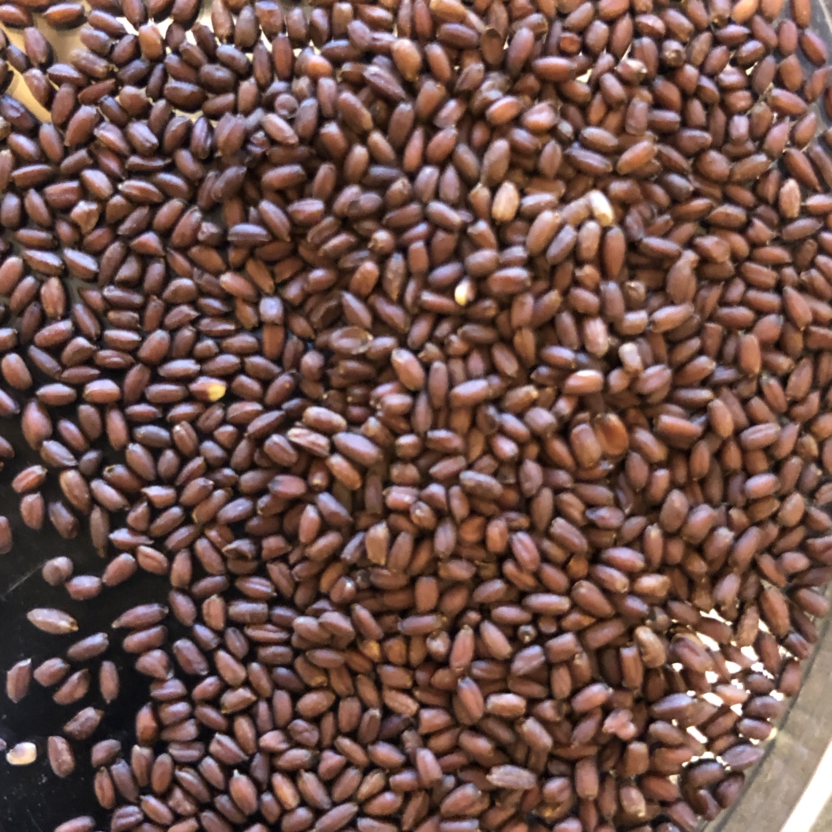
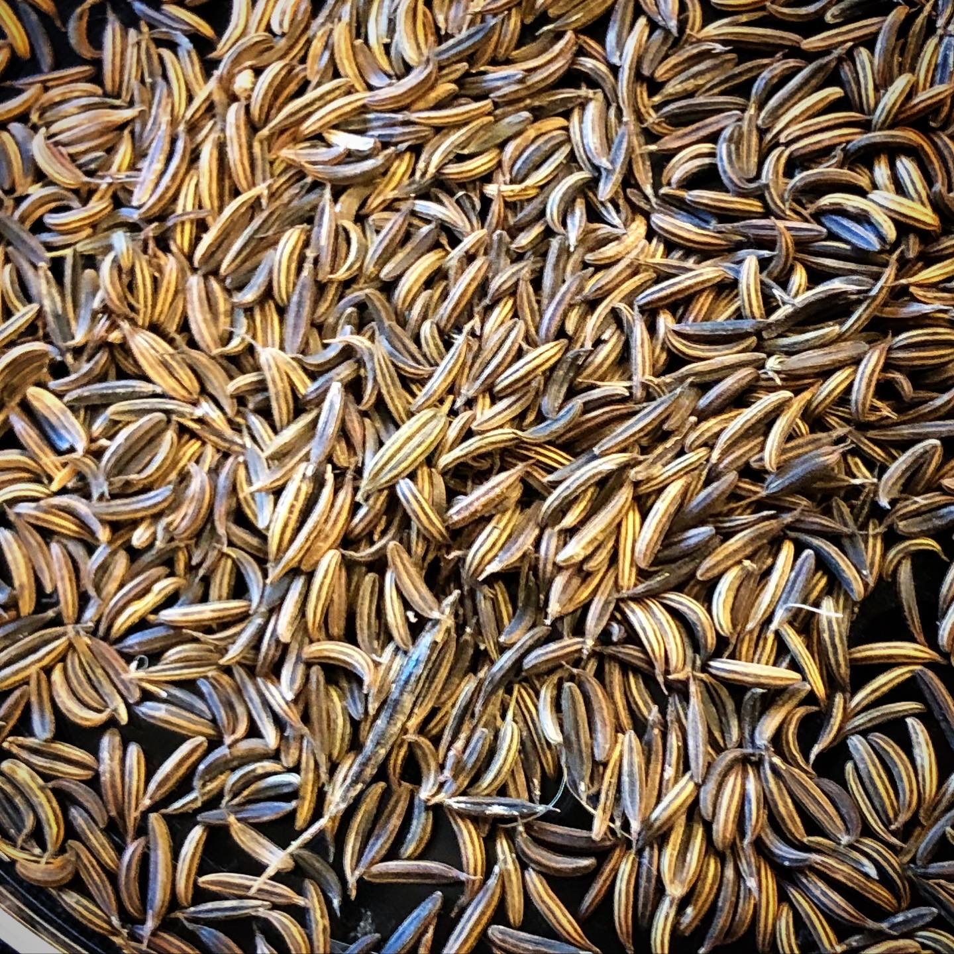
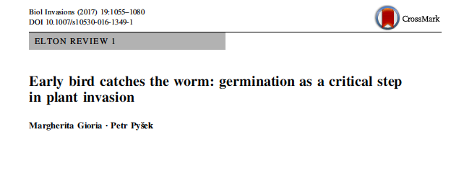
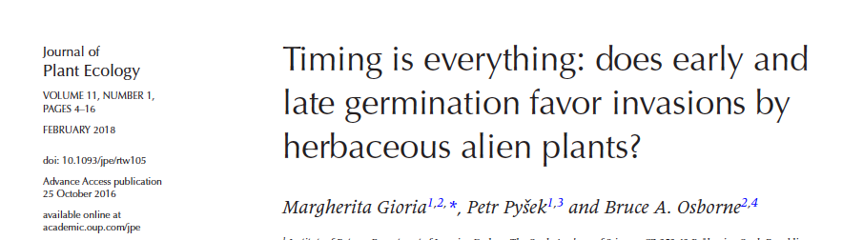
Seasonal Priority Effect:
Early germinators begin drawing down resources before the competitors (niche preemption) and change the physical environment (niche modification).
Implications:
Good competitors become dominant
Weak competitors coexist

Slide 5
Q1: How strong is the influence of temperature variation on relative germination phenology among competing species?
“Germination (or phenological or seasonal) advantage”
Q2: Does relative germination phenology impact competition?
“Seasonal (or germination) priority effect”
Q2a: Does this enhance the competitive success of invaders?
What is known about Q1:
Seeds with physiological dormancy can respond to several kinds of temperature cues.
The majority of experiments and models dealing with seedling emergence do not include multiple environmental factors.
What is known about Q2:
Yes, but experiments use a “sequential planting method” with no clear analogue to the "real world” .
Almost exclusively in grassland ecosystems.

Slide 6
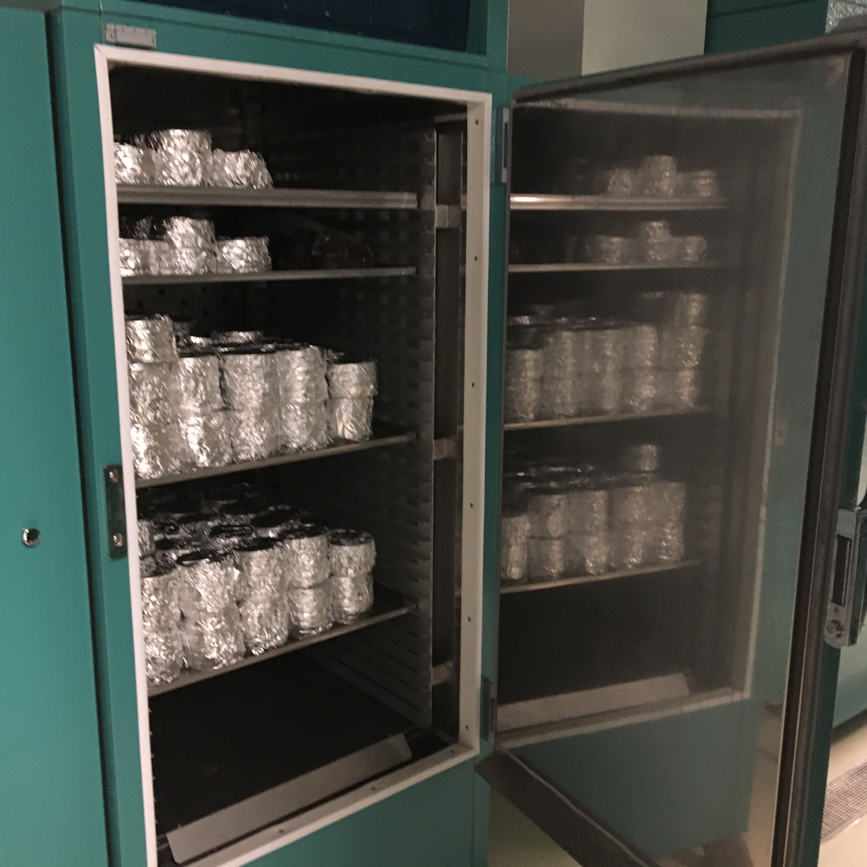
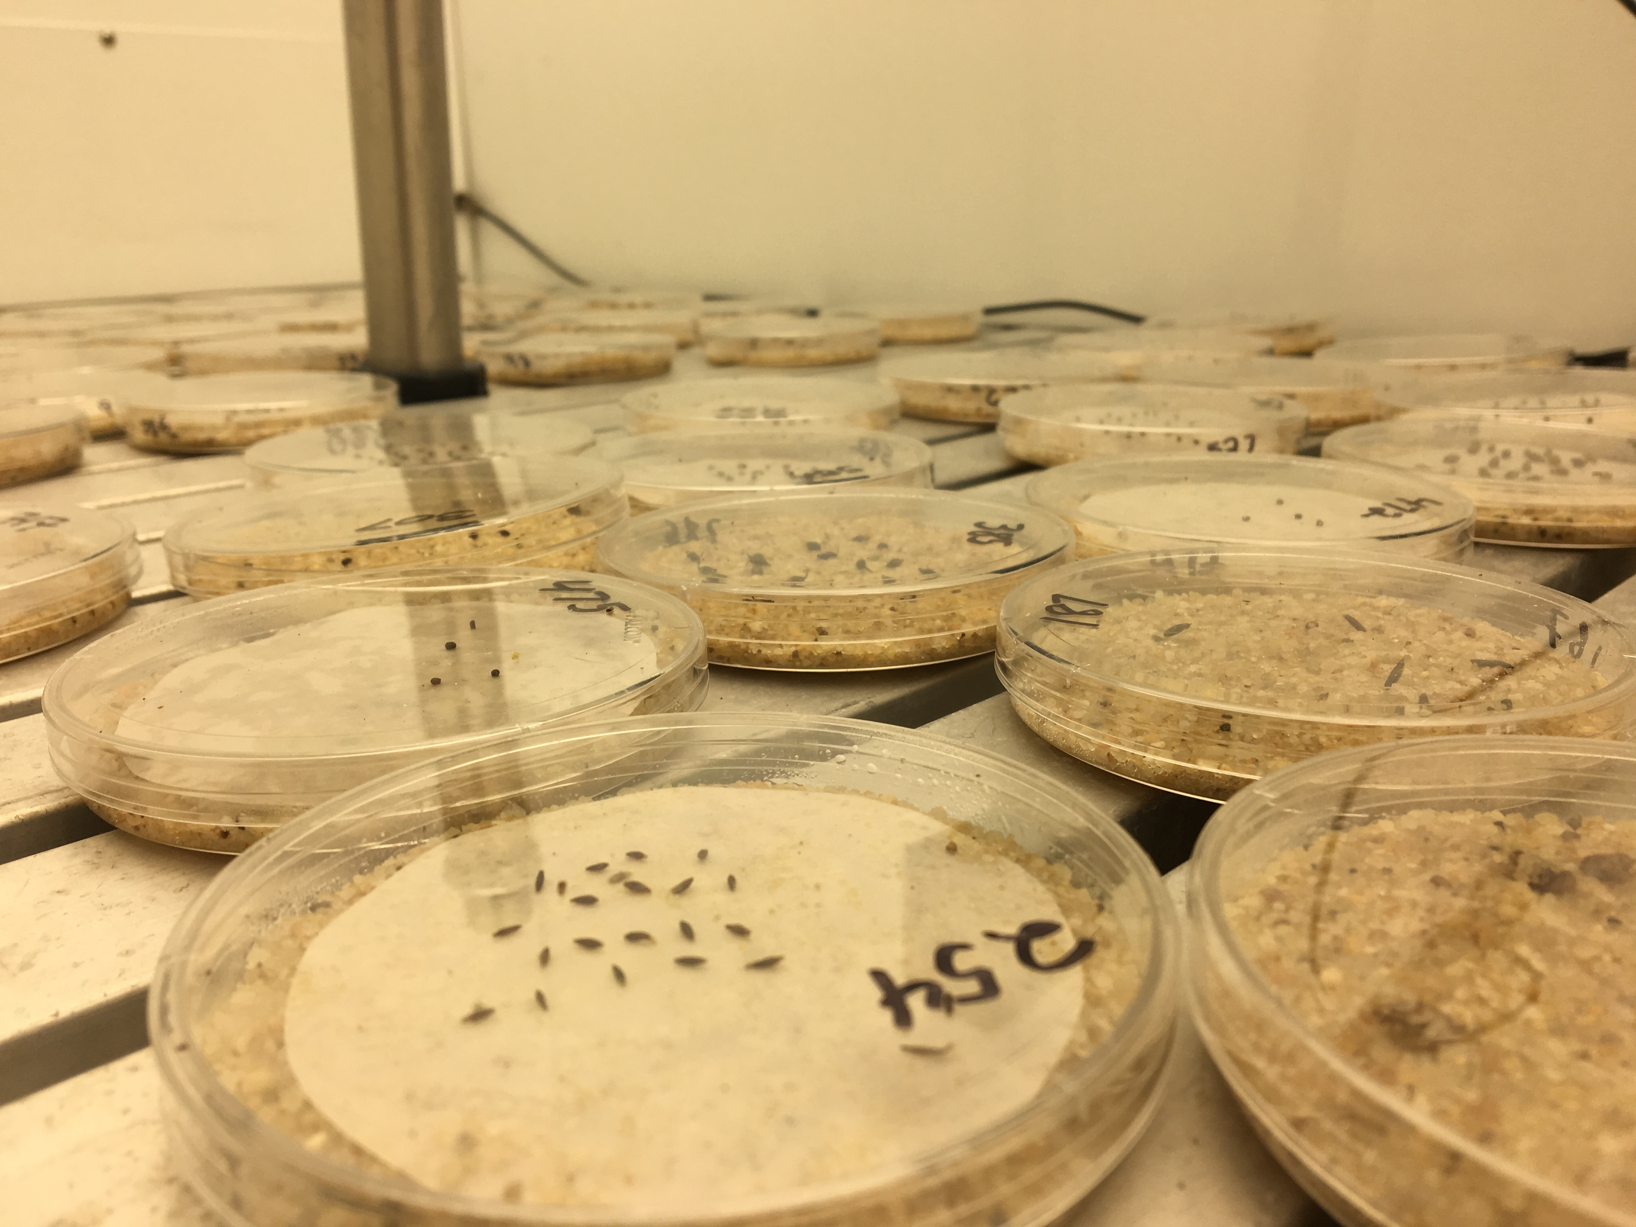
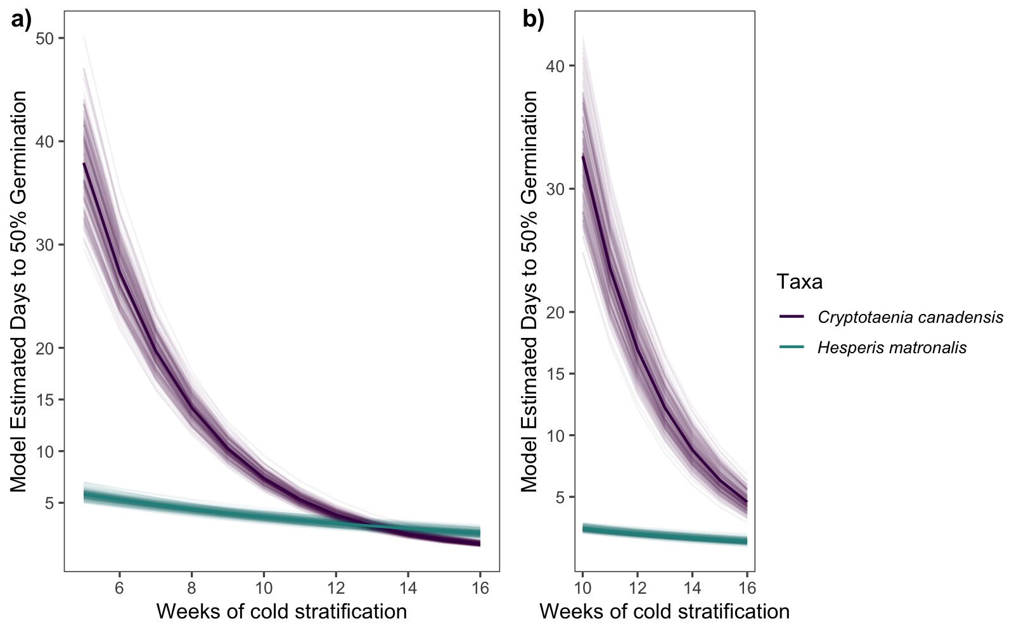
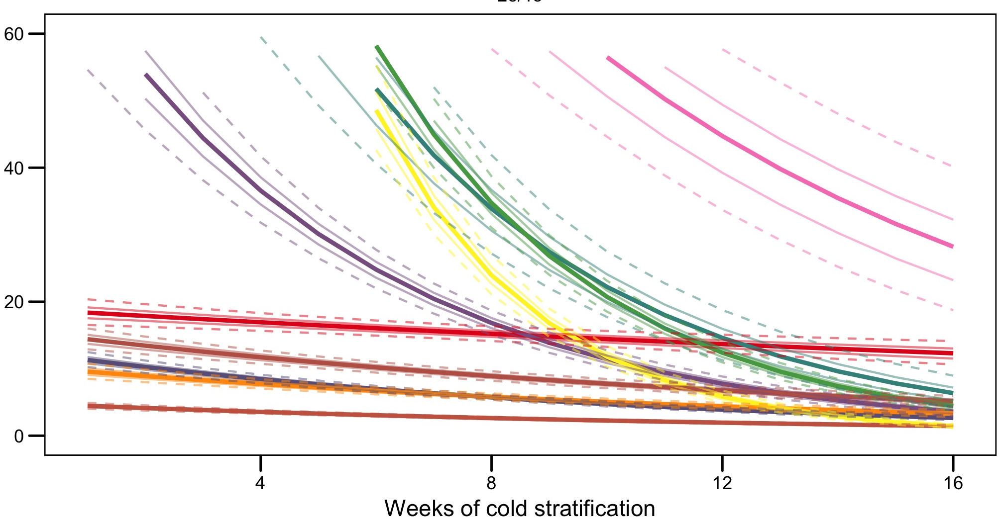
Cryptotaenia canadensis
Honewort
Hesperis matronalis
Dame’s Rocket
Treatments
11,407 seeds
14 species
10 levels of cold stratification (0-13 weeks at 4 C)
2 levels of incubation temperature (15 C, 20 C)

Slide 7
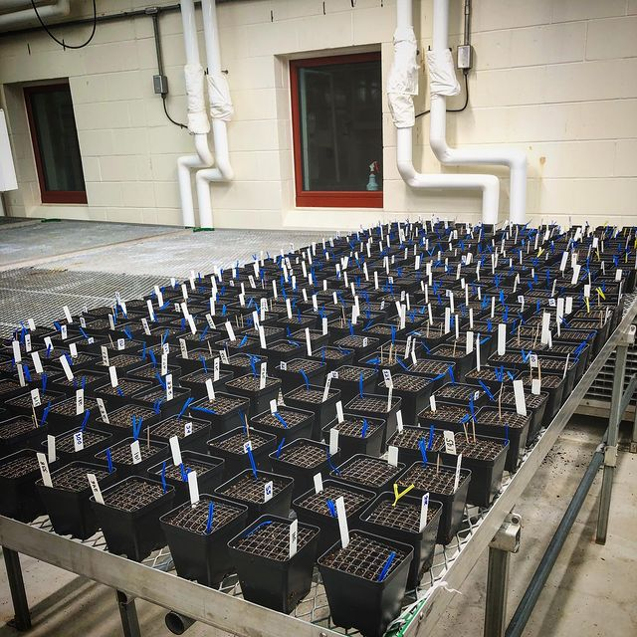
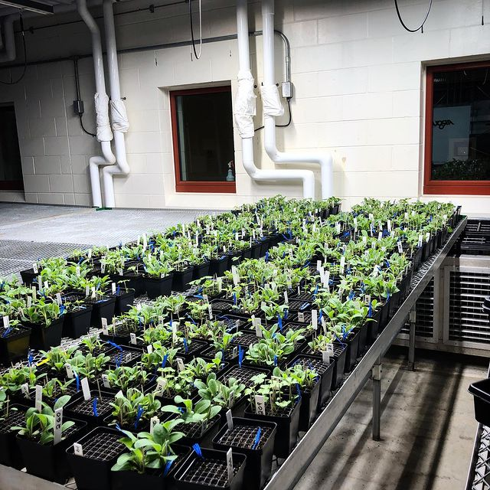
Cryptotaenia canadensis
Honewort
Hesperis matronalis
Dame’s Rocket
B=Above ground biomass/ species/pot
RGRD = ln(Y₂/y₂)-ln(Y₁/y₁) = b₁n₁+b₂n₂+b_{priority}T+E
B_{per capita_sp1} = b_{inter}n₁+b_{intra}n₂+b_{priority}T+E
Competition coef= b_{inter}/b_{intra} vs. (b_{inter}+b_{priority})/b_{intra}
B_{per capita}=B/n_{germinated/species/pot}

Slide 8
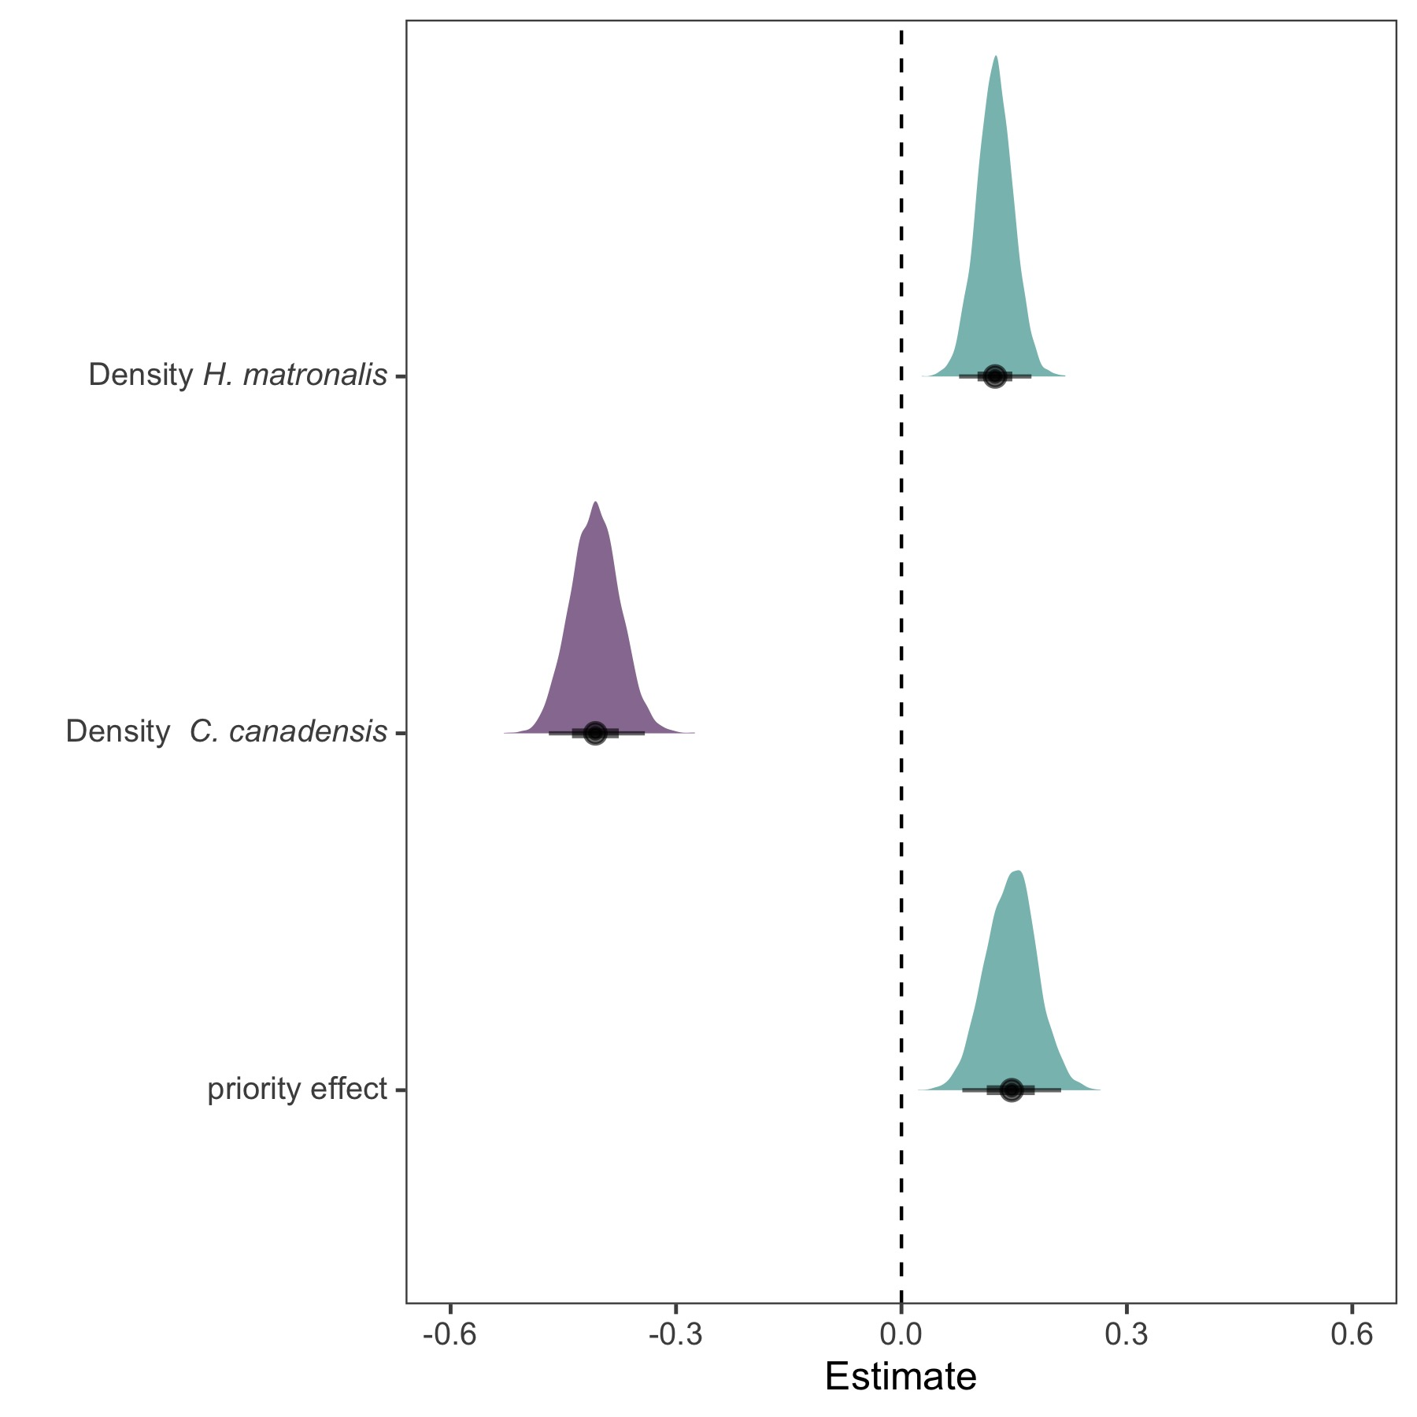
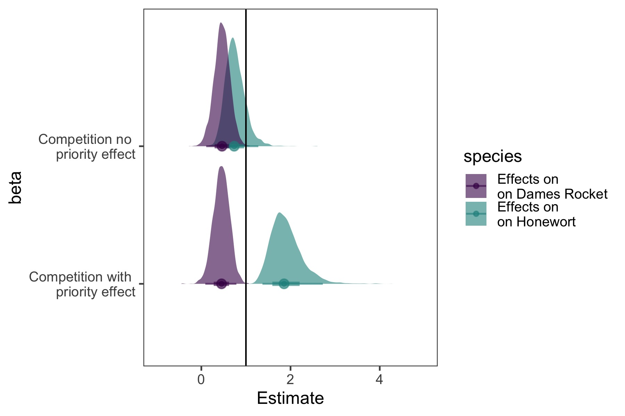
B_{per capita_sp1} = b_{inter}n₁+b_{intra}n₂+b_{priority}T+E
Competition coef= b_{inter}/b_{intra} vs. (b_{inter}+b_{priority})/b_{intra}
RGRD = ln(Y₂/y₂)-ln(Y₁/y₁) = b₁n₁+b₂n₂+b₃T+E
Complementary or redundant?
B_{per capita} is a derived quantity
+- Closely related to an established framework
- Raw data plots look wonky
+/- can’t handle monocultures (less data)
“niche” metric
+ Experiment was designed based on it
+ Easier to see temporal vs non-temporal effects
+Raw data plots look better

Slide 9
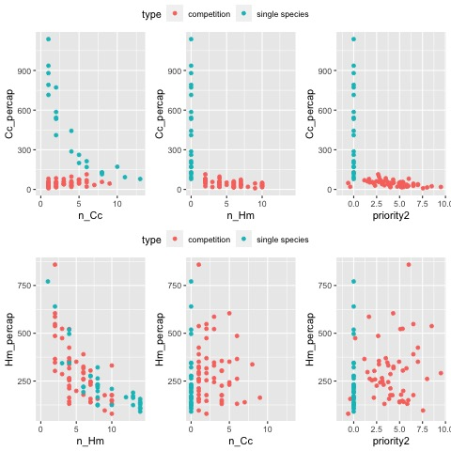
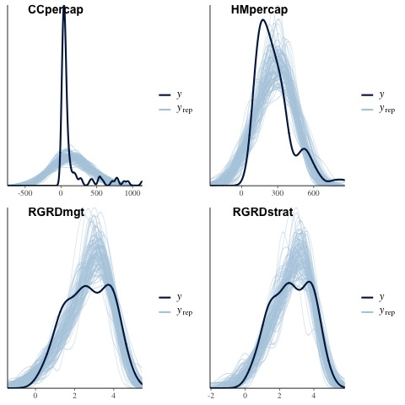
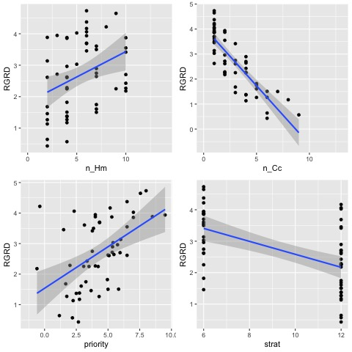
Raw Data

Slide 11
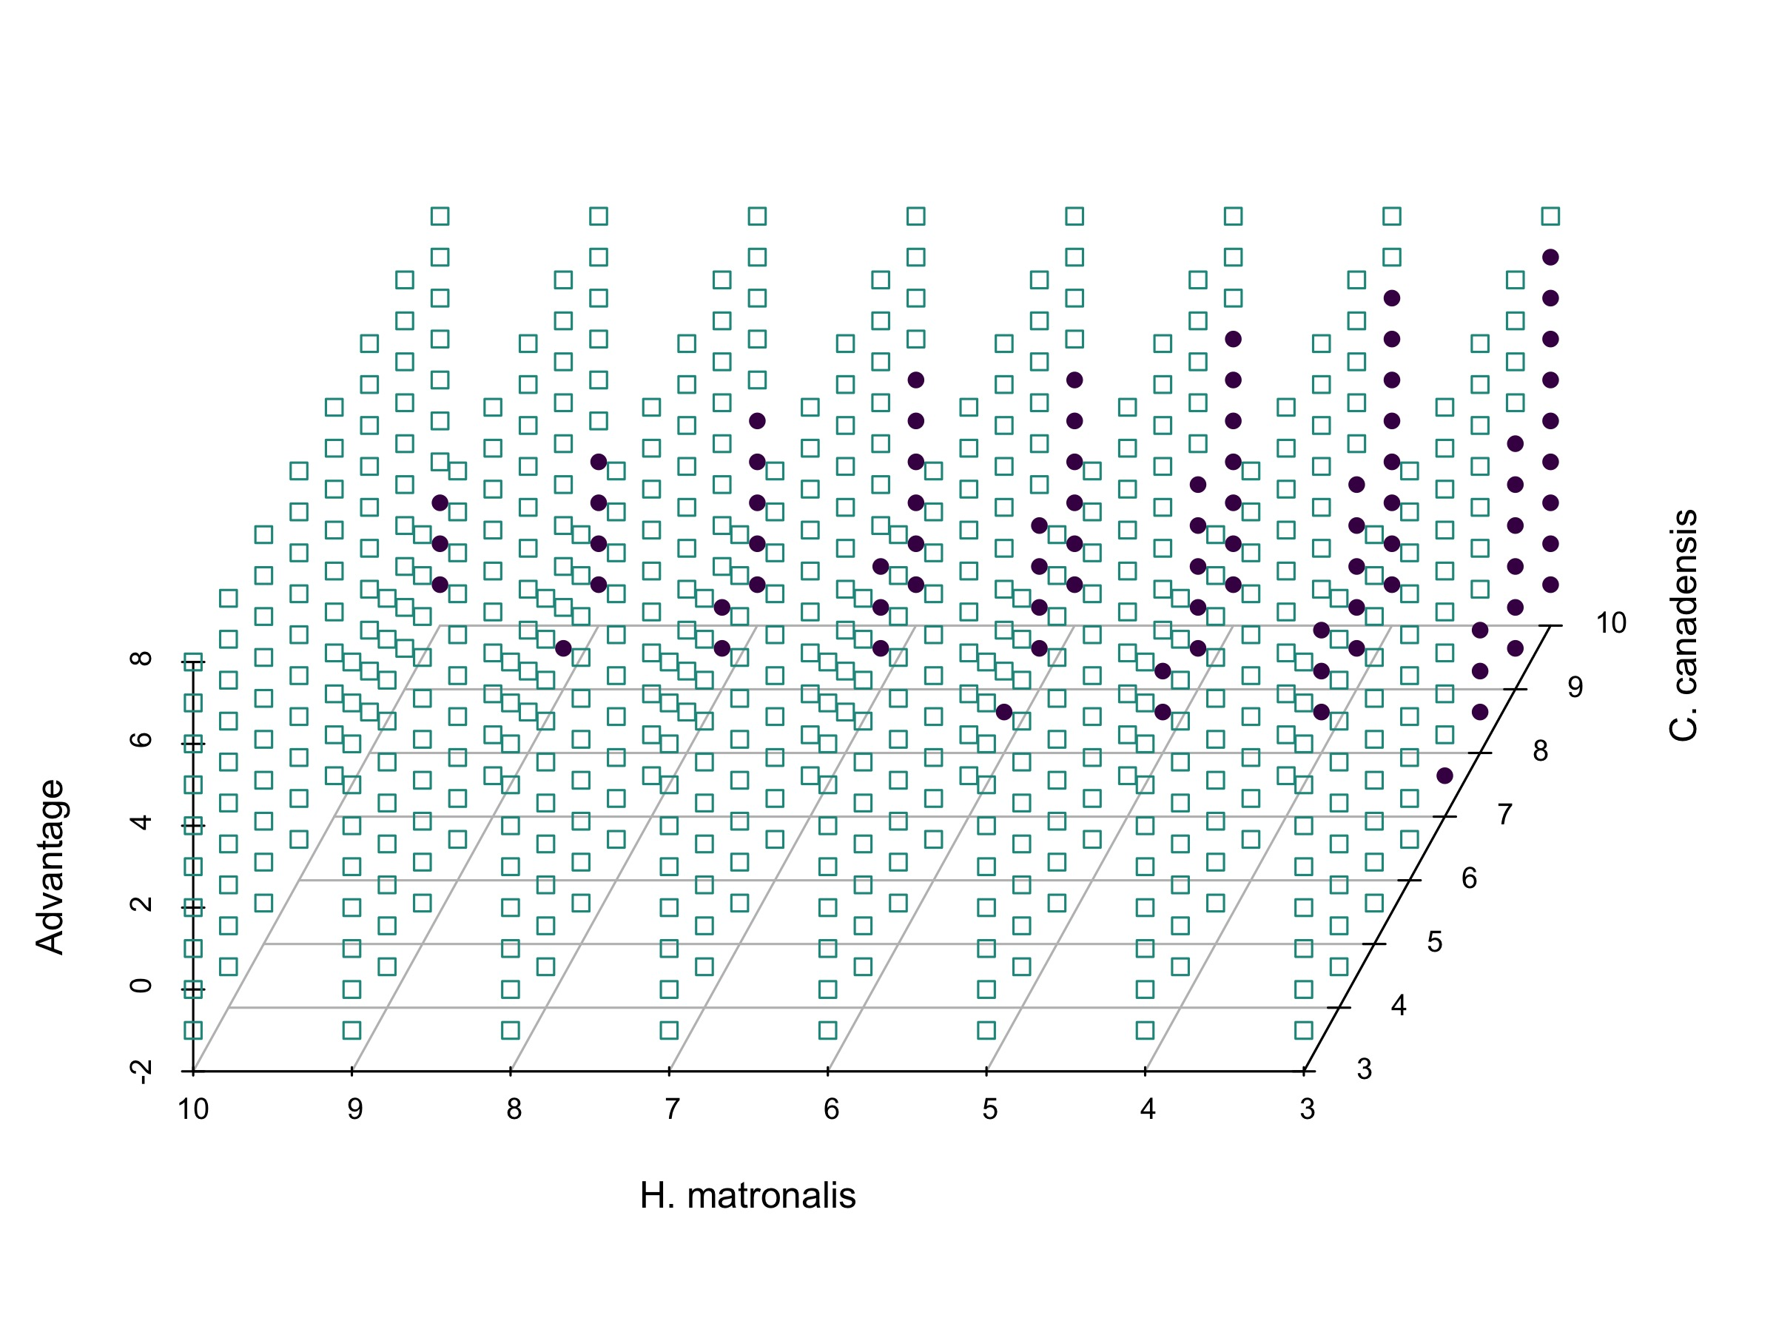

Slide 12
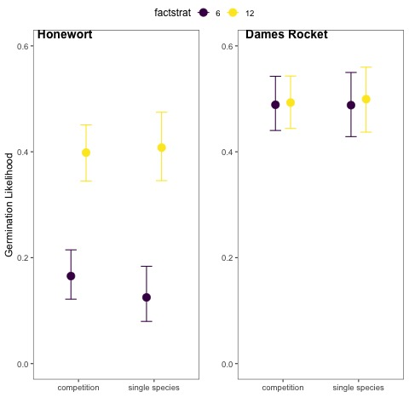
Niche modification?
At least, not apparent at the germination/seedling boundary

Slide 13
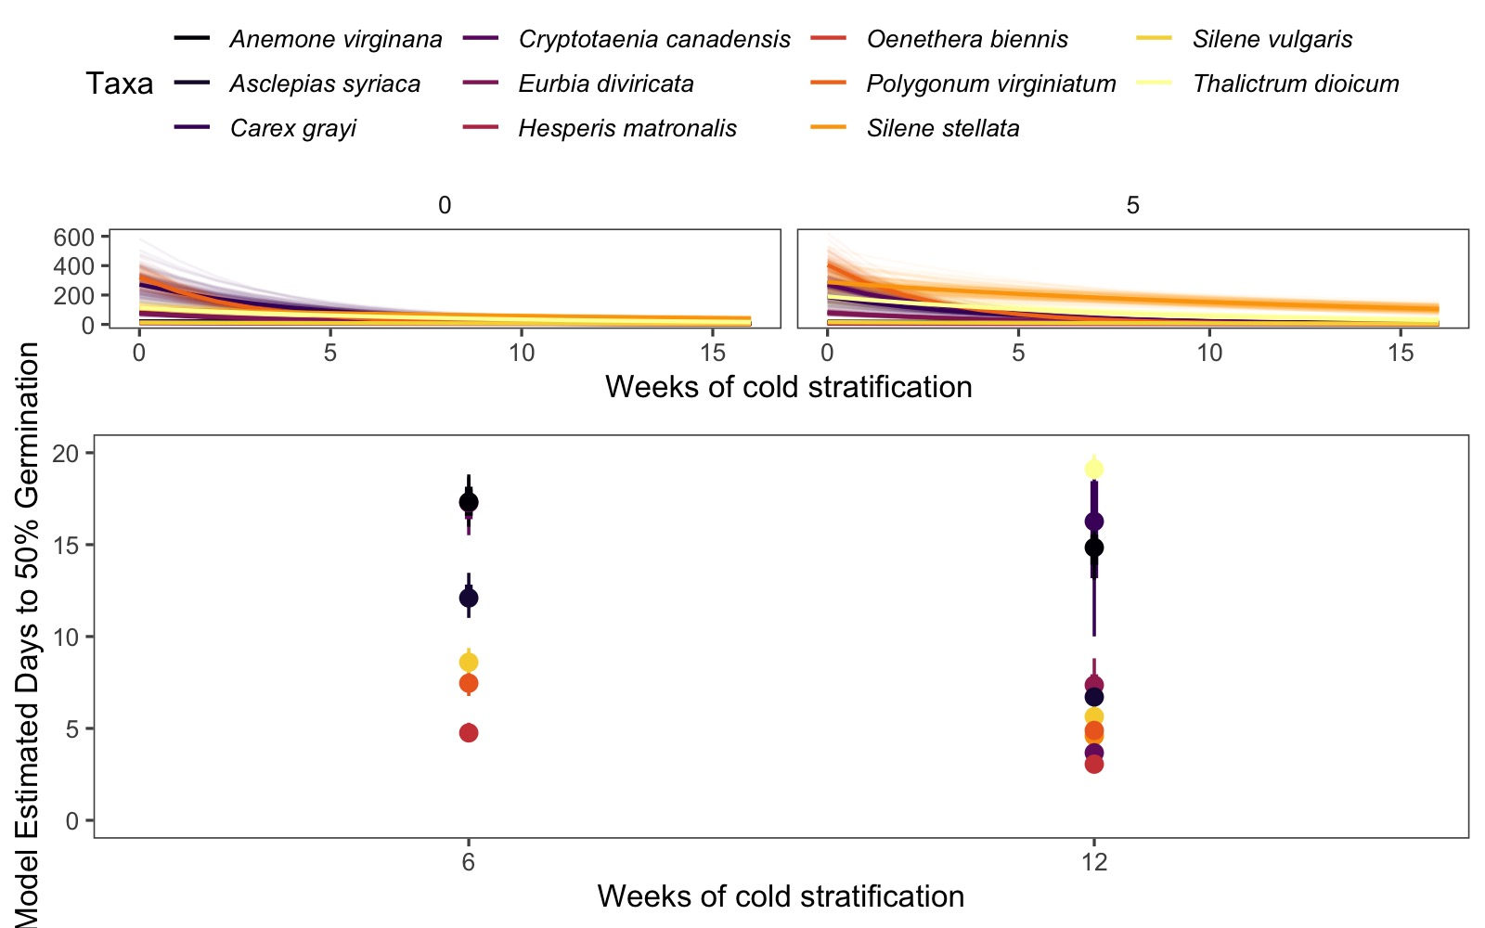

Slide 14
Methods summary:
While both modeling approach yield similar inference, relative growth rate difference (RGRD) seems to be a better approach with better fitting models.
Recap:
Variation in temperature (stratification and incubation) strongly influences the relative germination phenology among species
This variation can yield a strong seasonal priority effect on competitive outcomes
These phenological differences are what mediated the difference between coexistence and competitive exclusion in our experiment.*
*rephase if not presenting equations 1
There is no indication that early germinating species suppressed the germination of the later species, suggest that the interaction is occurring at the seedling stage
Submission goal: Biological Invasions

Slide 15
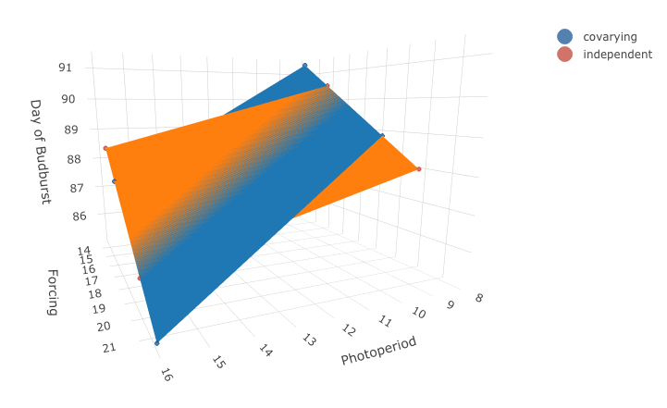
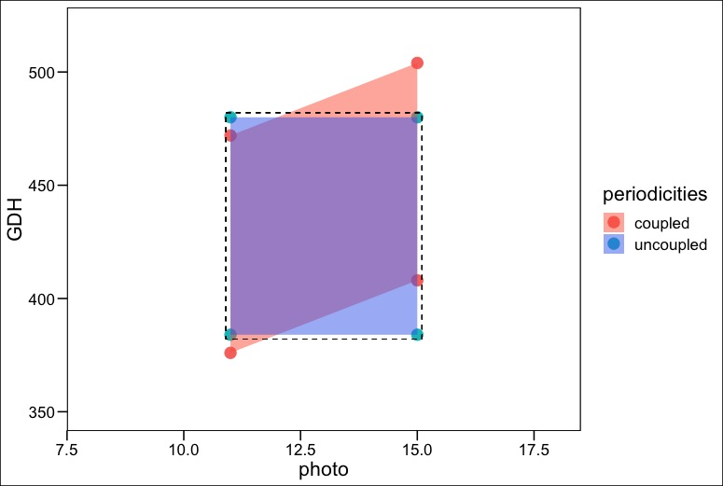

Goal: Compare effects of photoperiod and foricing
Treatments: 8 hours, 16 hours photoperiod
Treatments: 25/15, 20/10 day/night.
_______________________________________
T₁ daily mean T= (25*16+15*8/24)=21.66
T₂ daily mean T= (25*8+15*16)/24=18.33
T₃ daily mean T= (20*16+10*8)/24=16.6
T₄ daily mean T= (20*8+10*16)/24=13.33
Goal: assess photoperiod effect
Treatments: 8 hours, 16 hours photoperiod
Constant temperature 25/15 day/night.
_______________________________________
P₁ daily mean T= (25*16+15*8/24)=21.66
P₂ daily mean T= (25*8+15*16)/24=18.33
25% of studies that manipulate photoperiod appear to have this issue
Observed
Spring
Phenological
Responses in Experimental Environments
Of the 15 experiments designed to test interactions, we think 7 have this issue

Slide 16
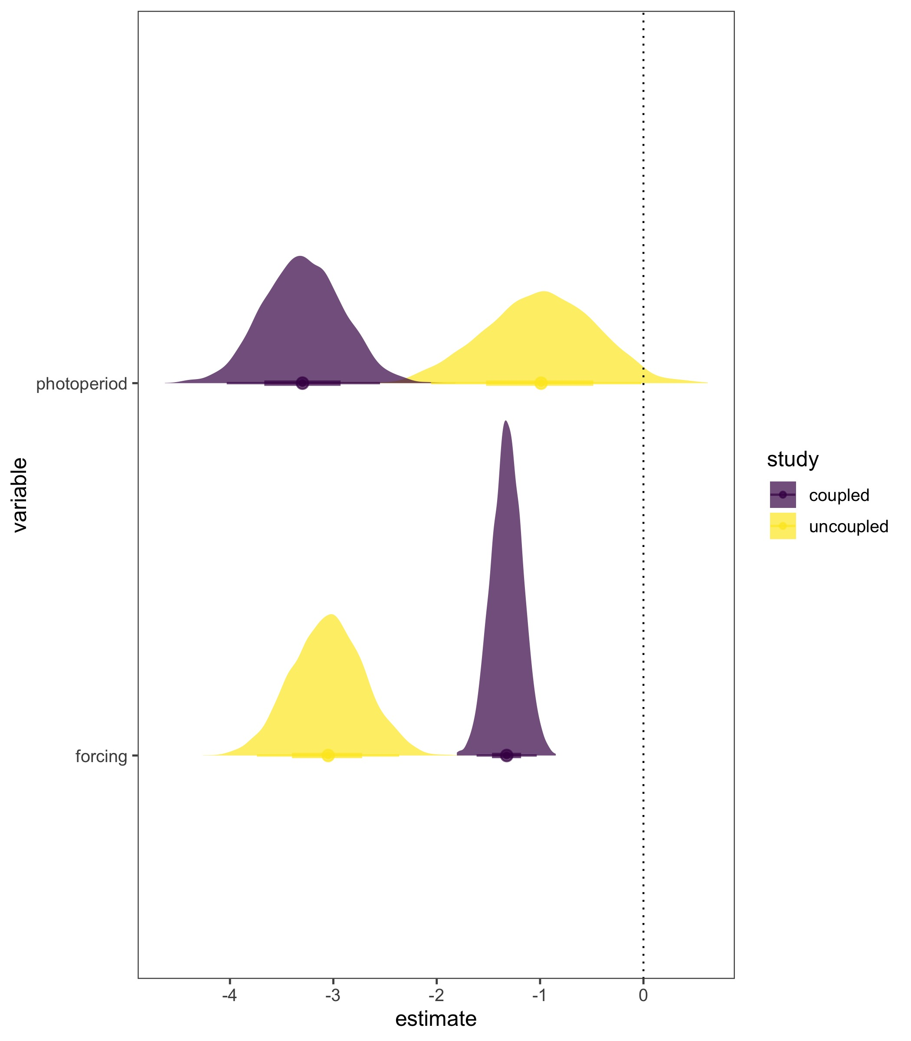
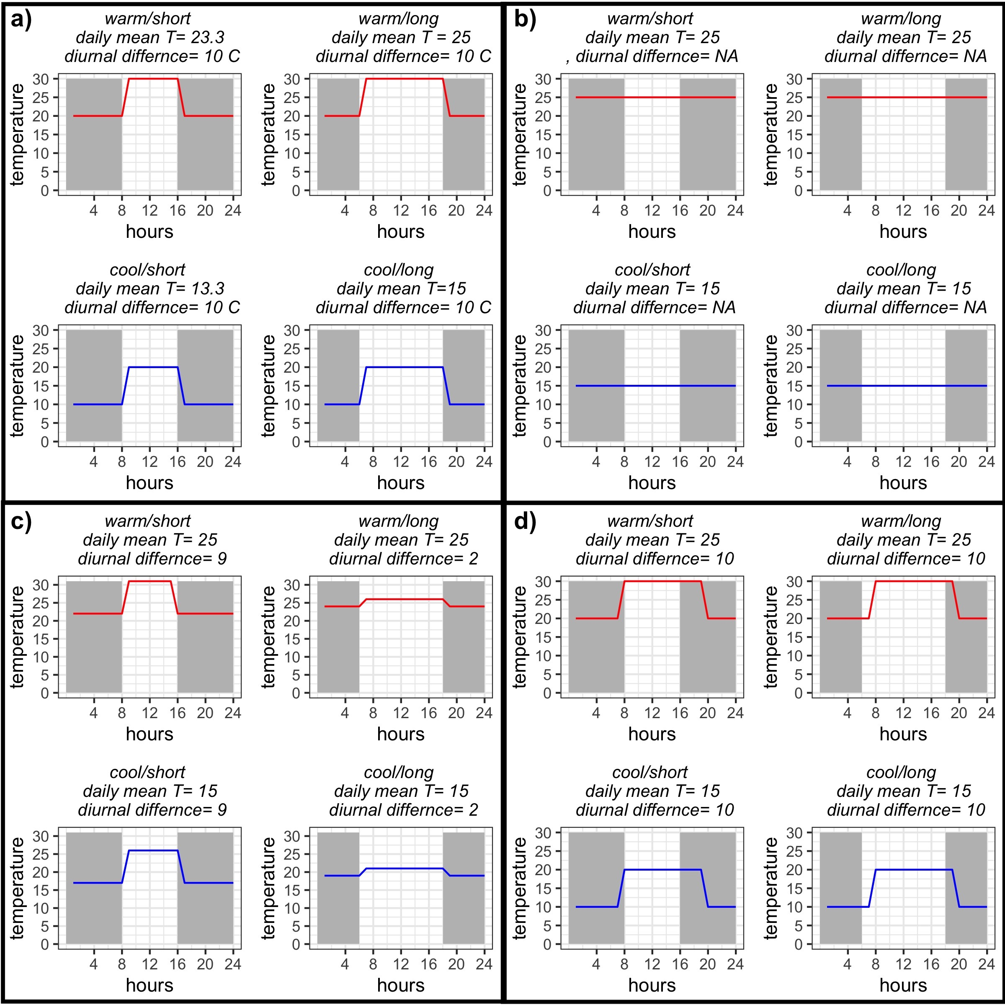
Prediction:
Periodicity covariation will overpredict photoperiod effect
Submission goal: Methods in Ecology and Evolution

Slide 17
To do:
Dissertation Introduction
Dissertation Conclusion
Chapter 3:
Experiment:
Analyses: [Confirm which to present]
Figures: [Confirm which to present]
Introduction: Edits
Methods: Edits
Results: Edits
Discussion: Outline to paragraph
Supporting Information: Incorporate other species
Chapter 4:
Experiment:
Analyses:
Figures: Improve 3D figure?
Writing: Edits
Supporting Information: Double triple check OSPREE statistics

Slide 18
April:
10 | 11 | 12 | 13 | 14 | 15 | 16
S | M | T | W | Th | F | Sa
24 | 25 | 26 | 27* | 28 | 29 | 30

